Slide 1


Acute Community Healthcare: Mobile Integrated Health
Collaboration in the post-discharge safety and medication management
a partnership between:
Contact John Loughnane at 617-620-5201

Slide 2
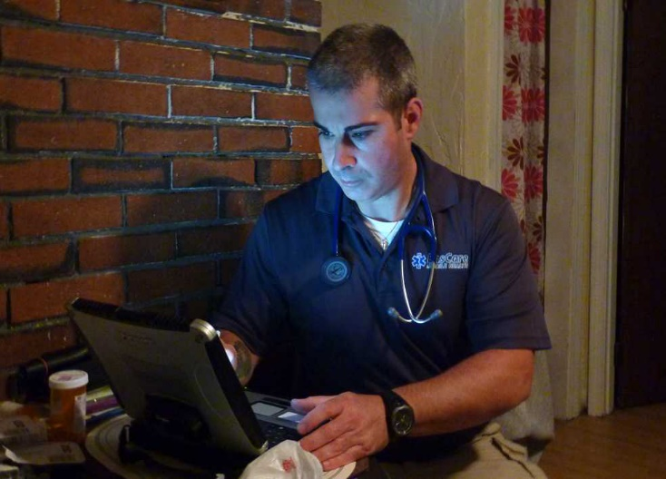
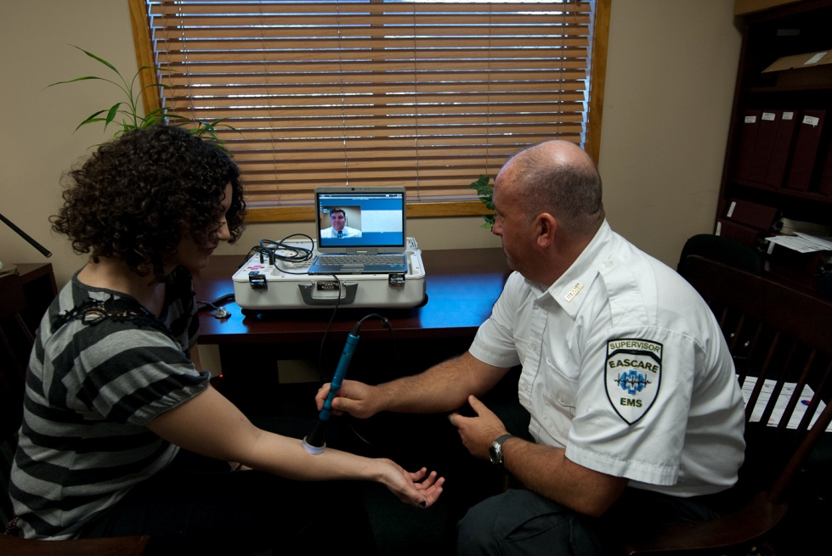
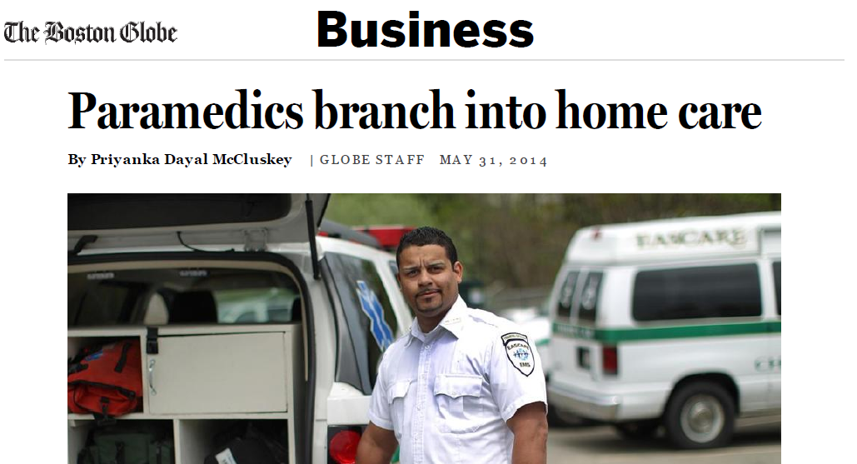
Mobile Integrated Healthcare
Introduction to Mobile Integrated Healthcare (MIH)
History of MIH
Local program and recent developments
Recognition and plans for expansion

Slide 3

Transitional Care Program
Program Development
Gap Analysis:
  Home Safety
  Medication
  Patient Education
Application Developed
Closed Loop System Created

Slide 4

Transitional Care Program
Point of Contact
Patient
EasCare Liaison
Discharge Staff

Slide 5
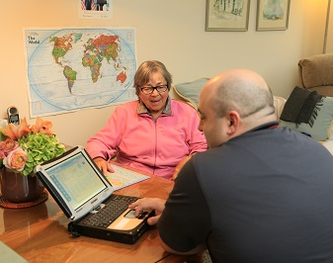
Transitional Care Program
DATA
51 visits
4% 5 day readmission
21.3% 30 day readmission
80.4% Medication Discrepancy
8 immediate readmissions likely adverted

Slide 6
Medication Discrepancies
41/51 patients had a discrepancy
  Nebulizer, CPAP not at home
  Meds not at home or pharmacy
  Discharge instructions or dosing unclear

Slide 7
Case Study
Friday 22:34 Increasing Snow (10” predicted)
77 y/o F s/p Fall with fx Hip.
DC’d from Rehab-SNF to Private residence, NO family with pt, PCA due next day at 11 am
    PMHx: CAD, Osteoporosis, HTN, Depression, Diabetes Type II

Slide 8
Summary
For low cost and in a short period of time, the Post-Discharge Program was successful in a number of categories
  Medication errors were identified
  Hospital re-admissions were avoided
  Unnecessary costs and utilization was avoided
  Patient satisfaction improved
  Overall patient care and experience was BETTER

